Slide 1

Don’t Kill Your Golden Goose?
Richard Esplin, Alfresco

Slide 2

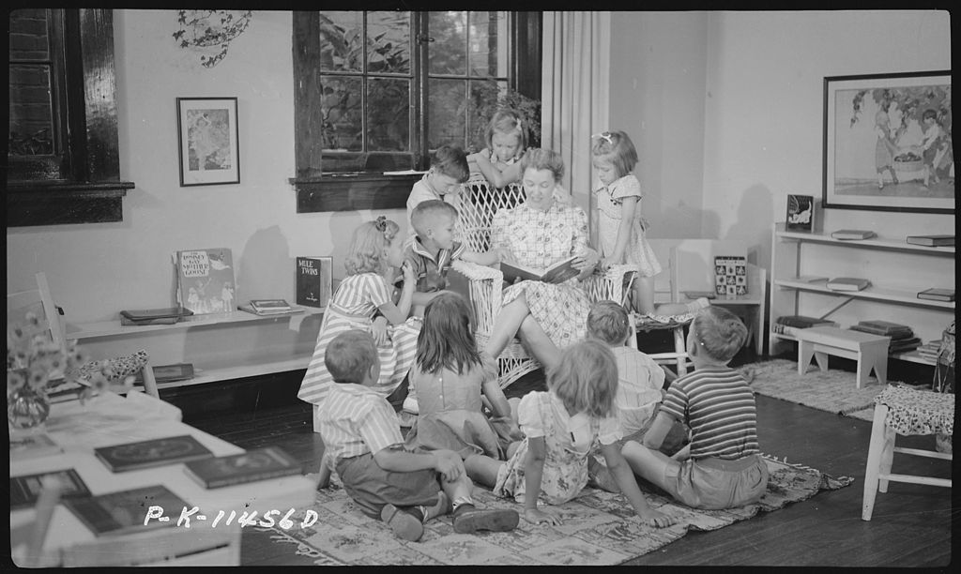

Slide 3
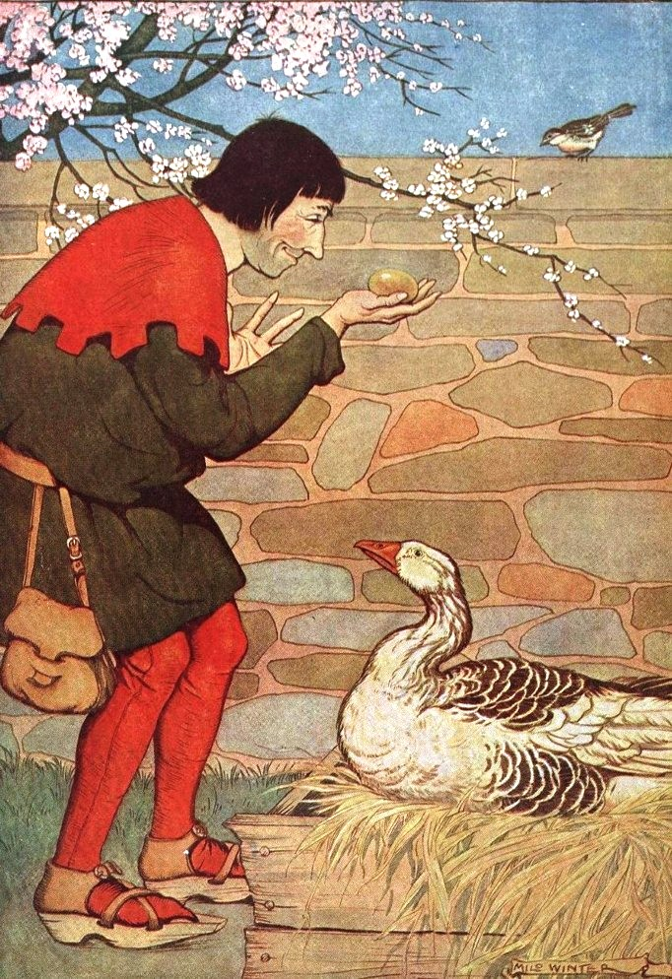

Slide 5
Two Possible Endings

Slide 6
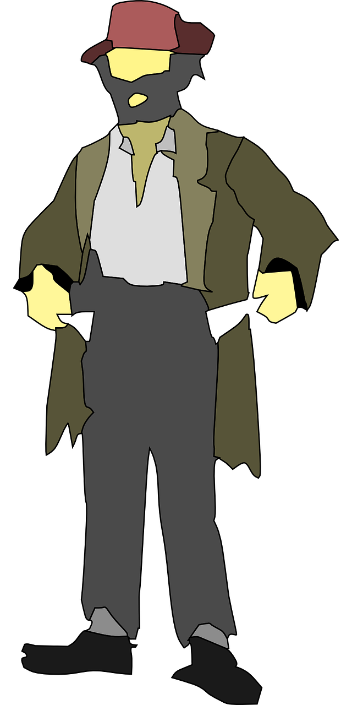
Traditional: Poverty and Sorrow

Slide 7
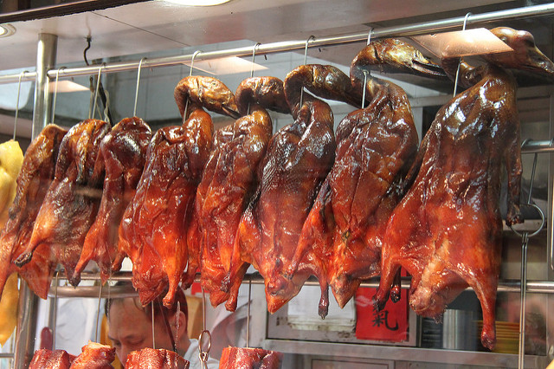
Market Pivot: Prosperity and Happiness
Image Credit: https://www.flickr.com/photos/geographyalltheway_photos/13090587564

Slide 8
Important warnings:
There is more than one tale about a “Golden Goose”. This my version.
My application of this tale demonstrates my opinion only, and does not reflect an official position of Alfresco.
The discussion that follows surfaces more questions than answers.

Slide 9

Alfresco’s challenge

Slide 10
AWS Might Be The Most Widely Adopted Computing Platform in History

Slide 11
AWS innovations we want in Alfresco:
Encryption and key management
Lambdas
Step functions
Analytics and search (Athena and RedShift)
Machine learning
Elasticity

Slide 12
Drivers of an open core business:
Adoption Upsell

Slide 13
Customers choose open source for (in order):
Choice and control
Development transparency
Vendor independence
Speed of procurement
Culture
Social responsibility

Slide 14
The calculus of open core strategy changes in the cloud:
There are disruptive advantages to the cloud.
There are other ways to achieve most of the benefits of open source.
Customer priorities are changing.
Adapt or die.

Slide 15
Are we building a niche business?

Slide 16
How big of a differentiator is open source today?

Slide 17
Will focusing on open source slow down our cloud innovation?

Slide 18
How far can a shim get us?

Slide 19
Can open source thrive when one vendor dominates the ecosystem?

Slide 20
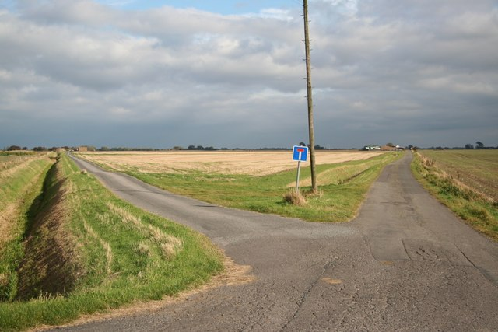
Our Choices Are Not Immediately Permanent

Slide 21

Time Will Tell

Slide 22
Continue the conversation:
http://community.alfresco.com

